Slide 1
Team Bible
Presentation
Let’s get this (daily) bread
Brought to you by Ari, Mert, and Artorius

Slide 2
FIRST: A HISTORY LESSON
PRESENT
KING JAMES
The Living Bible, The New American Standard Bible, and the New English translation are published
King James commissions a bible translation in English. Not the first,
1200 BC TO
0001 AD
1960
1970-2001
1611
CONCEPTION
AMERICAN STANDARD BIBLE
Theoretically this is when the original bible was written. The Old Testament was written in Hebrew, New Testament in Greek.
The American Standard Version is published from the King James translation

Slide 3

Current Literature
Living bible comparisons (close reading)
Text analysis on different versions
We want to join these together!

Slide 4
THE GAP
GENERAL COMPUTATIONAL ANALYSIS
01
COMPARISON
02
CLOSE READING
03
(NON-TRADEMARKED)

Slide 5
OUR GOAL:
Discover if The Living Bible (TLB) is more or less similar to the King James Version (KJV) than other modern translations (NET and ANSB)

Slide 6
WHY? FOR WHOMST?
AVERAGE CHRISTIANS
TRANSLATION SCHOLARS
Bring justice to TLB once and for all.
Is paraphrasing in general worse?

Slide 7
METHODS
 | GOAL | METHODS
1 | Organize Data | Extract verse, chapter, and book from data
2 | Find Sentiment | Break apart verses and find sentiment values
3 | Relative Sentiment | Divide sentiment values by the word count
4 | Normalize Sentiment | Min-max normalization
5 | Find Differences | Subtract normalized sentiment vectors

Slide 8
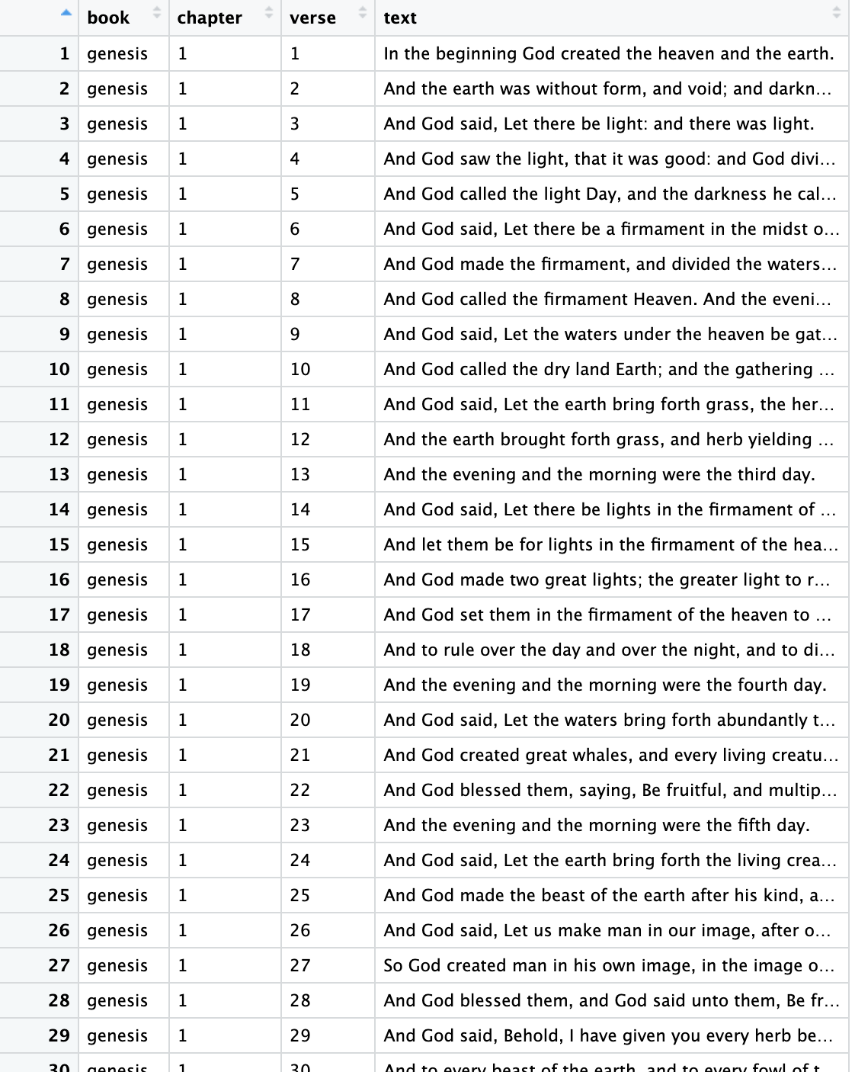
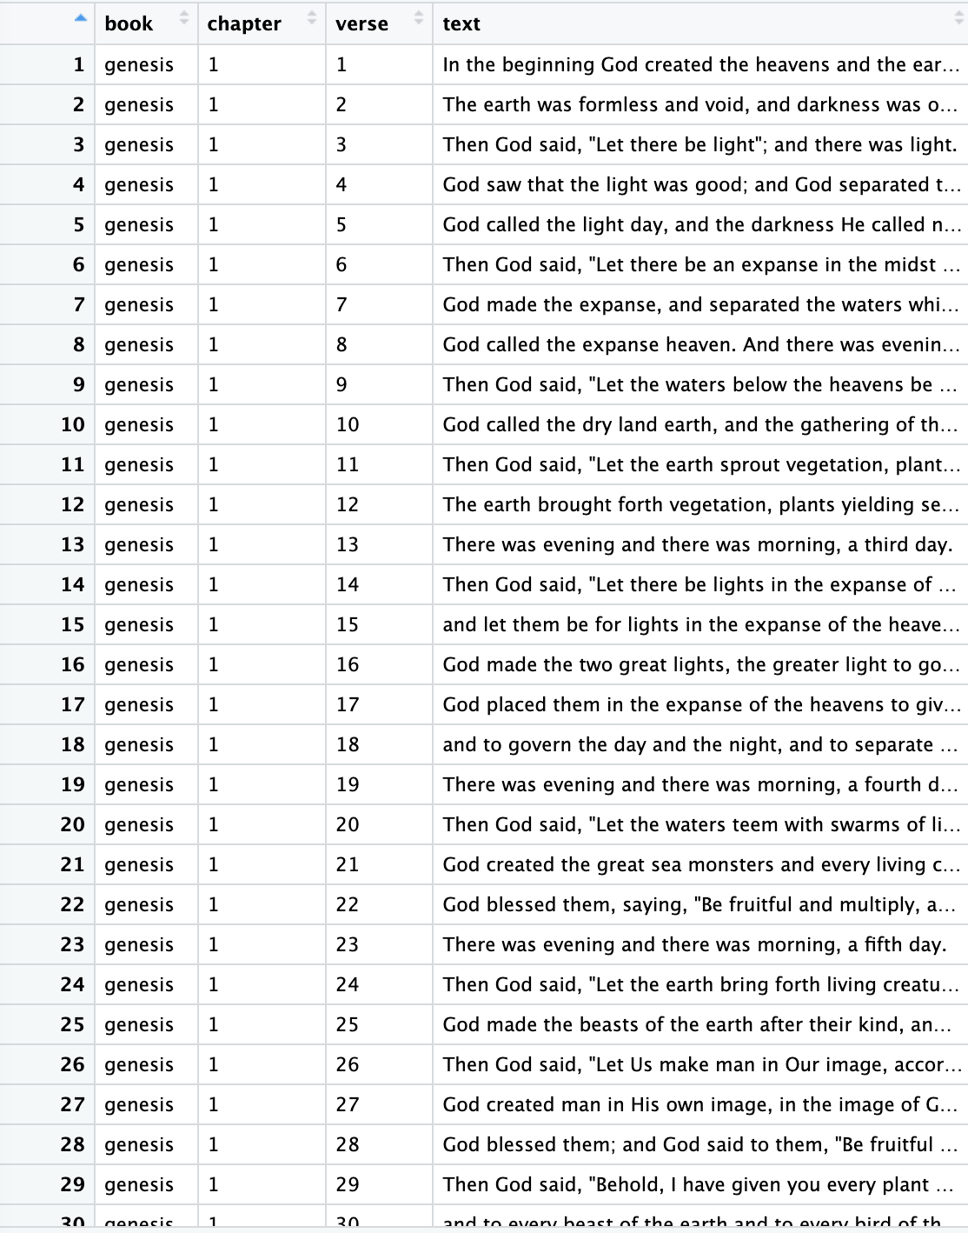
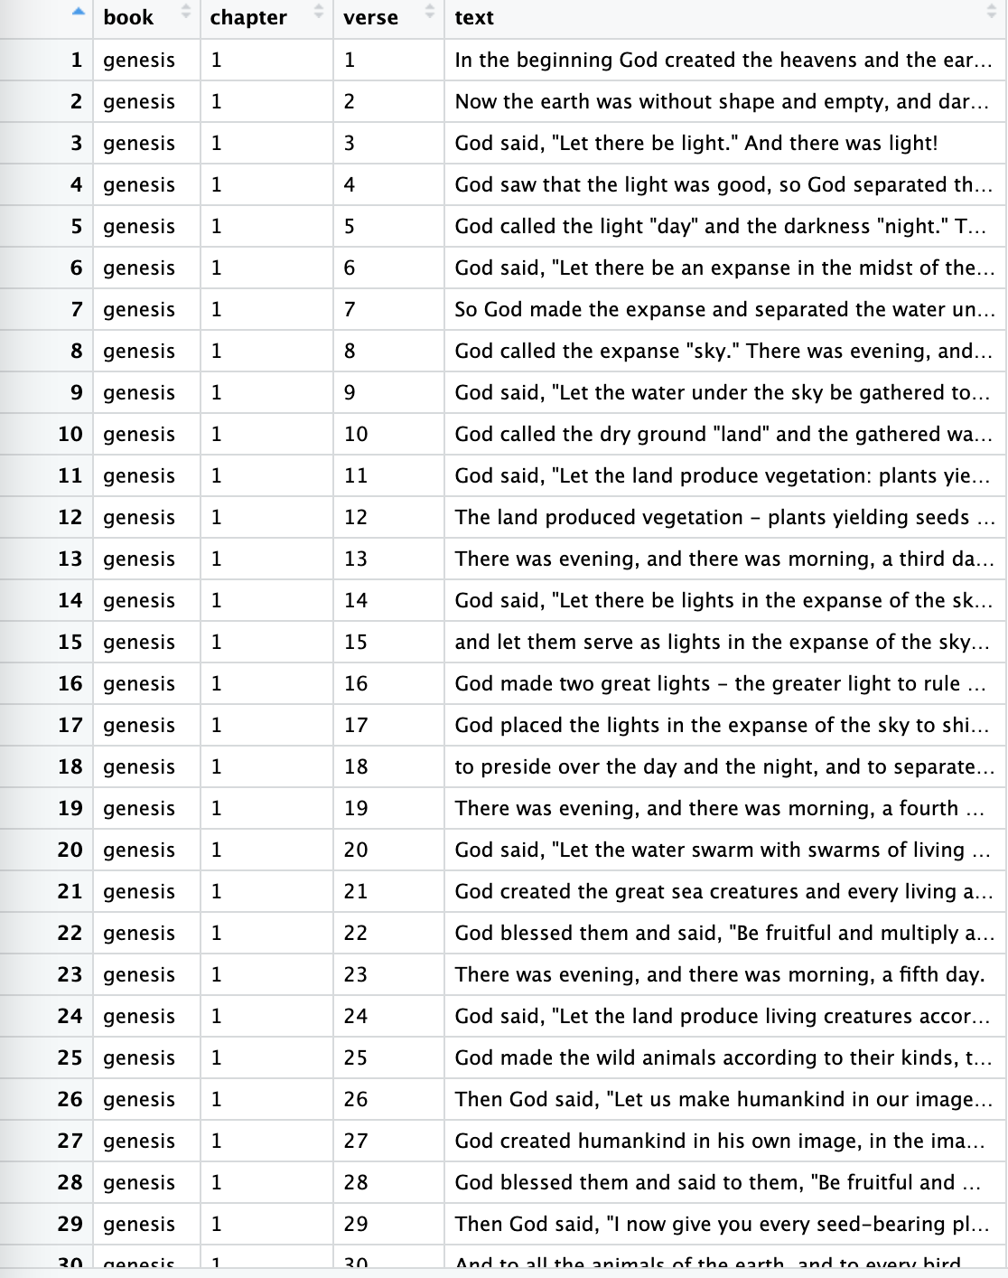
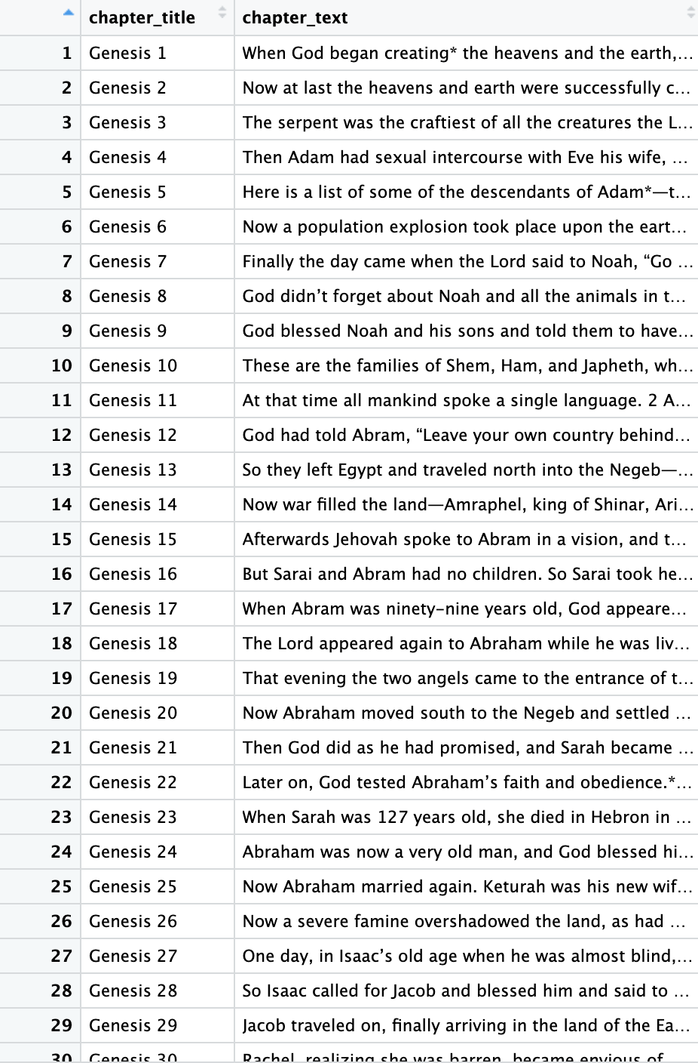
STEP ONE: ORGANIZE DATA
 | KJV | NASB | NET | LIVING

Slide 9
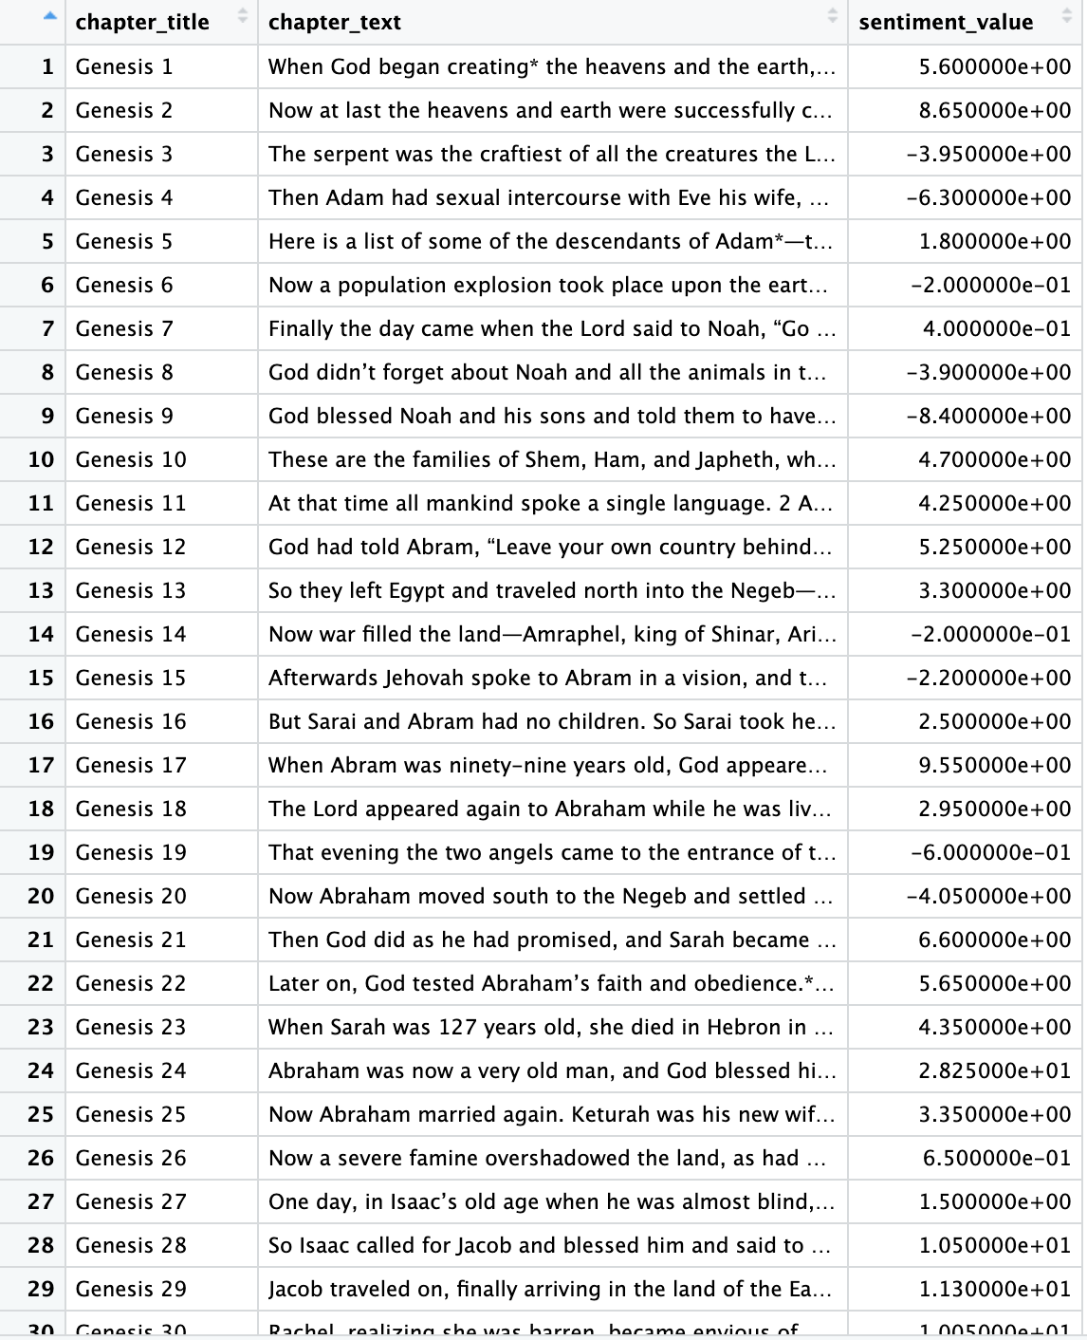
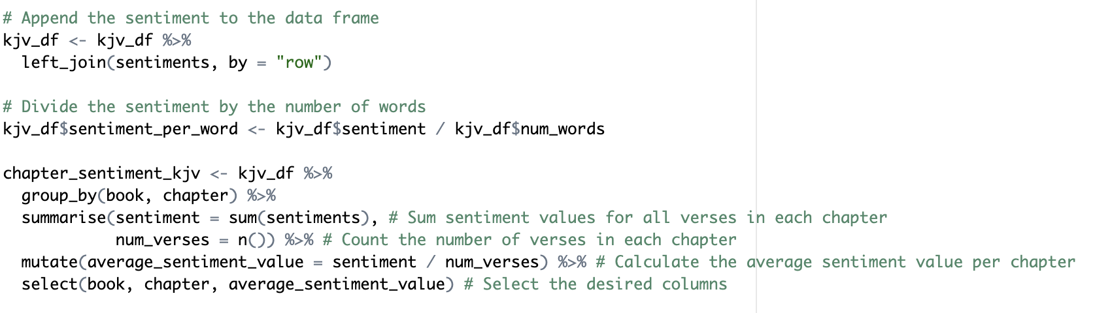
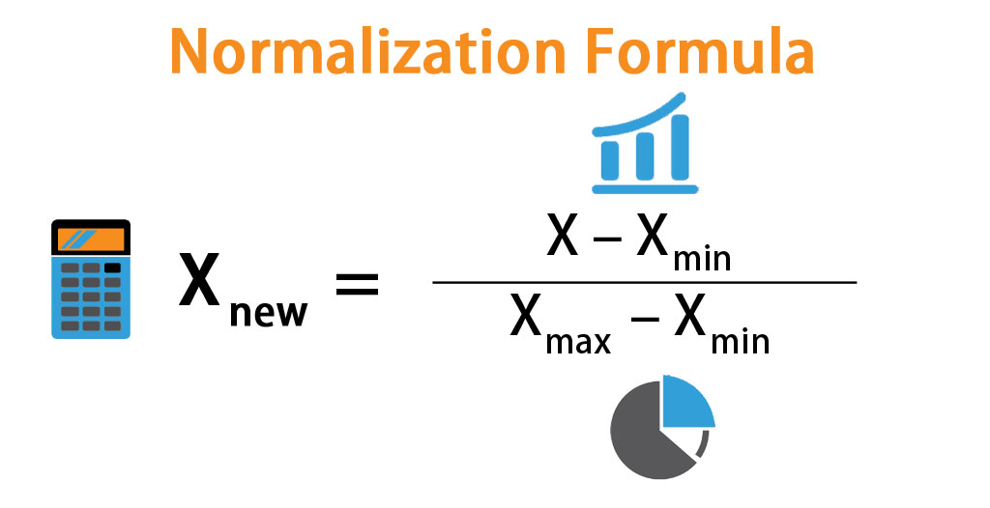
STEP TWO, THREE, FOUR: SENTIMENT ANALYSIS
*Relative Sentiment:
Sum Raw Sentiment / Total Word Count

Slide 10
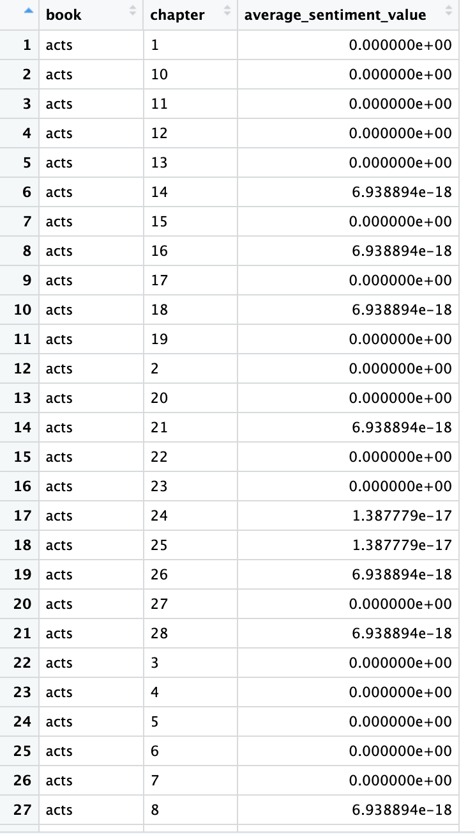
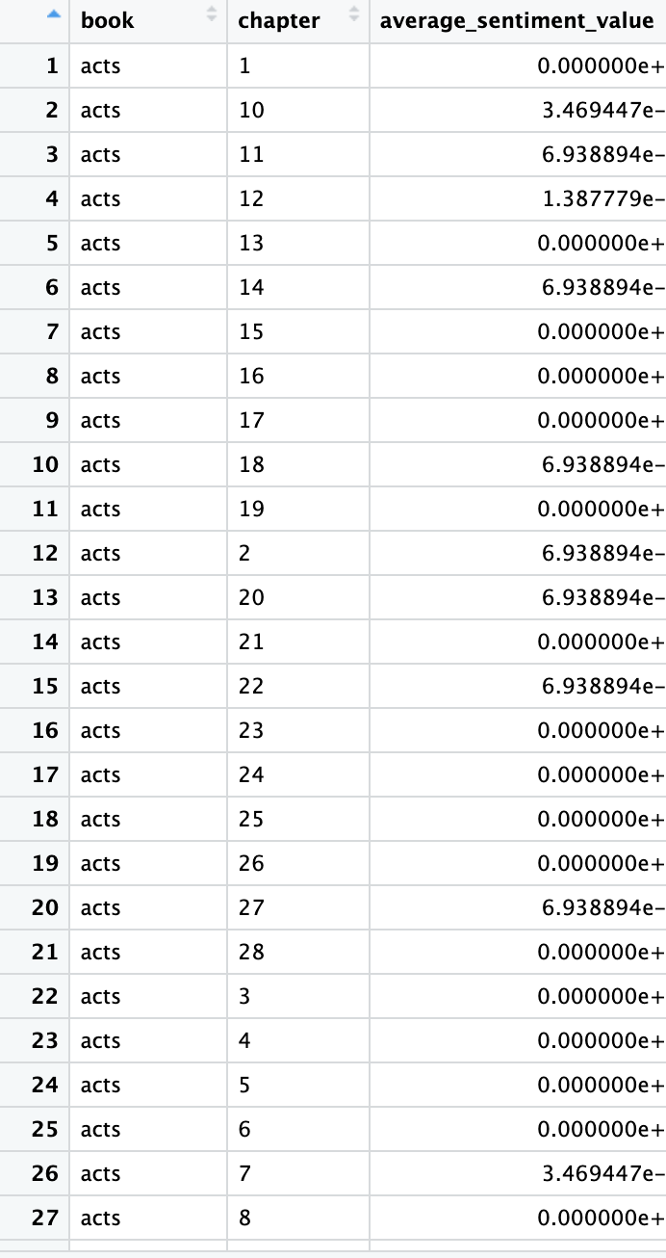
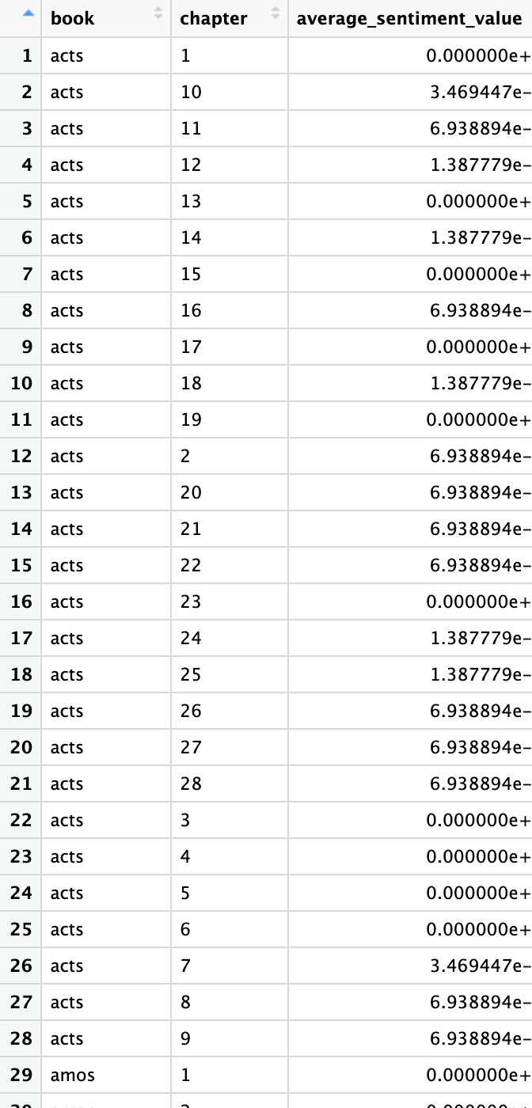
STEP FIVE: FIND DIFFERENCES
 | KJV vs NASB | KJV vs NET | KJV vs LIVING

Slide 11
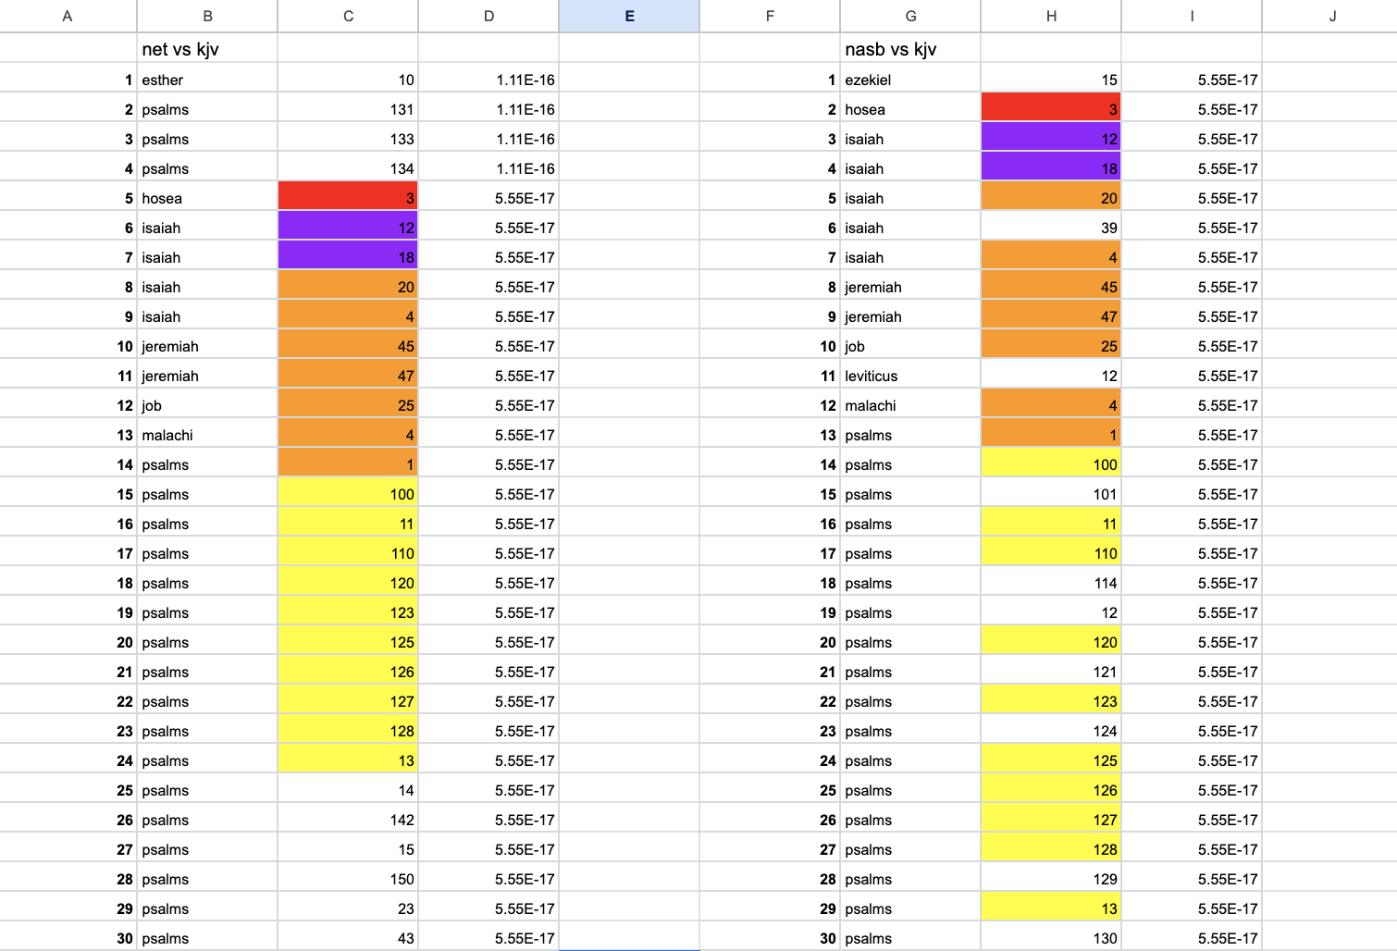
OVERALL RESULTS (TOP 30)
PSALMS
ISAIAH
OTHERS
UNMATCHED
36,7%
Research: two systems
13,3%
Warnings and hopes
16,7%
Jeremiah, Job, Hosea, etc.
33,3%
No matched chapter
General Comparison of the matched verses

Slide 12

CLOSE READING
HOSEA CH 3 VERSES 1-5
Our computational contender
LEVITICUS CH 18 VERSE 22
Our cultural contender

Slide 13
HOSEA 3 : 1-5
NASB
1 Then the LORD said to me, "Go again, love a woman who is loved by her husband, yet an adulteress, even as the LORD loves the sons of Israel, though they turn to other gods and love raisin * cakes."
2 So I bought her for myself for fifteen * shekels of silver and a homer and a half of barley.
3 Then I said to her, "You shall stay with me for many days. You shall not play the harlot, nor shall you have a man; so I will also be toward you."
4 For the sons of Israel will remain for many days without king or prince, without sacrifice or sacred pillar and without ephod or household idols.
5 Afterward the sons of Israel will return and seek the LORD their God and David their king; and they will come trembling to the LORD and to His goodness in the last days.
KJV
1 Then said the LORD unto me, Go yet, love a woman beloved of her friend, yet an adulteress, according to the love of the LORD toward the children of Israel, who look to other gods, and love flagons of wine.
2 So I bought her to me for fifteen pieces of silver, and for an homer of barley, and an half homer of barley:
3 And I said unto her, Thou shalt abide for me many days; thou shalt not play the harlot, and thou shalt not be for another man: so will I also be for thee.
4 For the children of Israel shall abide many days without a king, and without a prince, and without a sacrifice, and without an image, and without an ephod, and without teraphim:
5 Afterward shall the children of Israel return, and seek the LORD their God, and David their king; and shall fear the LORD and his goodness in the latter days.
TLB
1 Then the Lord said to me, “Go, and get your wife again and bring her back to you and love her, even though she loves adultery. For the Lord still loves Israel though she has turned to other gods and offered them choice gifts.”
2 So I bought her back from her slavery for a couple of dollars and eight bushels of barley,
3 and I said to her, “You must live alone for many days; do not go out with other men nor be a prostitute, and I will wait for you.”
4 This illustrates the fact that Israel will be a long time without a king or prince, and without an altar, Temple, priests, or even idols!
5 Afterward they will return to the Lord their God and to the Messiah, their King, and they shall come trembling, submissive to the Lord and to his blessings in the end times.

Slide 14
LEVITICUS 18 : 22-23
NASB
22 'You shall not lie with a male as one lies with a female; it is an abomination.
23 'Also you shall not have intercourse with any animal to be defiled with it, nor shall any woman stand before an animal to mate with it; it is a perversion.
KJV
22 Thou shalt not lie with mankind, as with womankind: it is abomination.
23 Neither shalt thou lie with any beast to defile thyself therewith: neither shall any woman stand before a beast to lie down thereto: it is confusion.
TLB
22 “Homosexuality is absolutely forbidden, for it is an enormous sin.
23 A man shall have no sexual intercourse with any female animal, thus defiling himself; and a woman must never give herself to a male animal, to mate with it; this is a terrible perversion.

Slide 15
(TENTATIVE) FINAL THOUGHTS
Computationally, TLB seems to be more similar to NASB than KJV
In terms of language, KJV and NASB are the most similar, despite their major time differences
Overall it appears that TLB is the translation that is the most different from its original source, but the overall meaning behind the piece does not seem to change.
If one is a stickler for exact words, does TLB vs NASB matter?

Slide 16

IMPORTANT QUESTIONS
Do you think our results are generalizable to all (or most) paraphrased translations?
How do you think these results would differ if the ASV wasn’t a middle-man?

Slide 17
THANK YOU
FOR YOUR TIME AND ATTENTION <3
We would particularly like to give a shoutout to Professor Gabi, Mark Zuckerberg, and all of the sources found on the (informal) doc below
https://docs.google.com/document/d/1SNhYQ0pUDo43PUp7_8D-A2gWnvi0nMFe8OOaaQlOYrg/edit?usp=sharing

